Slide 1
Binary Numbers
Appendix A
Tanenbaum, Structured Computer Organization, Fifth Edition, (c) 2006 Pearson Education, Inc. All rights reserved. 0-13-148521-0

Slide 2
Numeric Systems
Non-positional number systems
Positional number systems
Tanenbaum, Structured Computer Organization, Fifth Edition, (c) 2006 Pearson Education, Inc. All rights reserved. 0-13-148521-0

Slide 3
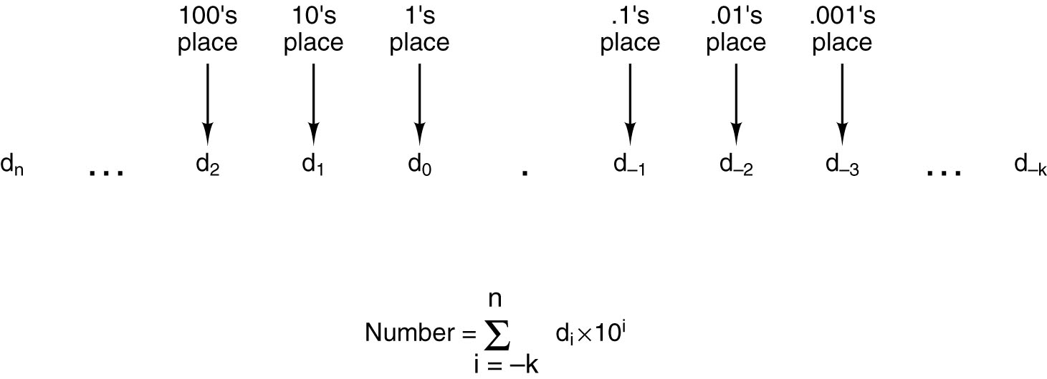
Radix Number Systems (1)
The general form of a decimal number.
Tanenbaum, Structured Computer Organization, Fifth Edition, (c) 2006 Pearson Education, Inc. All rights reserved. 0-13-148521-0

Slide 4
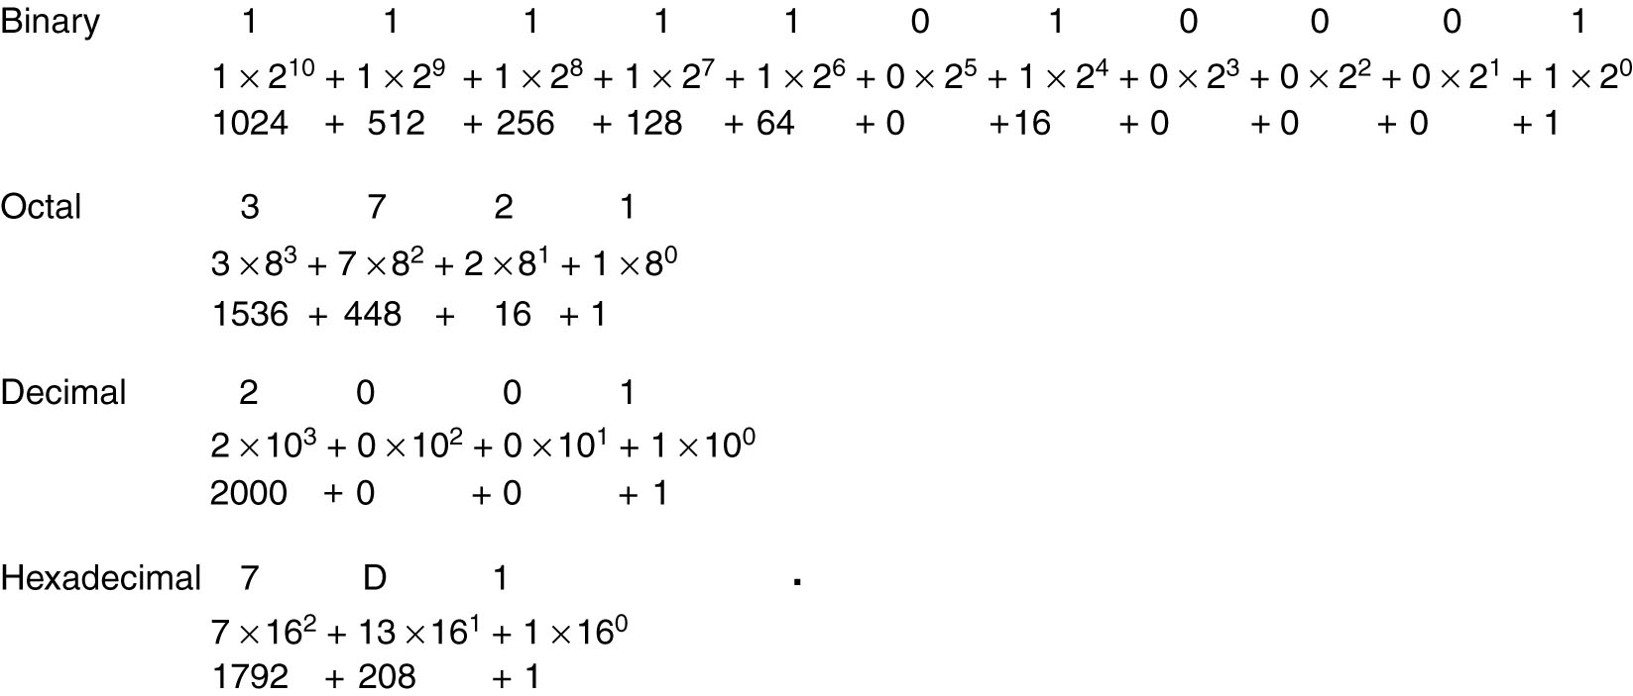
Radix Number Systems (2)
The number 2001 in binary, octal, and hexadecimal.
Tanenbaum, Structured Computer Organization, Fifth Edition, (c) 2006 Pearson Education, Inc. All rights reserved. 0-13-148521-0

Slide 5
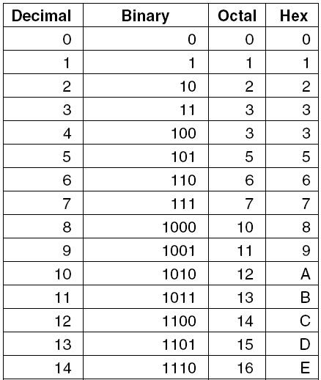
Conversion from One Radix to Another(1)
Decimal numbers and
their binary, octal, and
hexadecimal equivalents.
Tanenbaum, Structured Computer Organization, Fifth Edition, (c) 2006 Pearson Education, Inc. All rights reserved. 0-13-148521-0

Slide 6
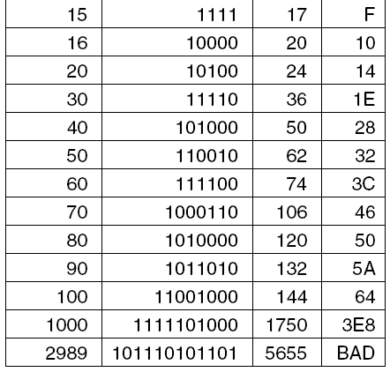
Conversion from One Radix to Another(2)
Decimal numbers and
their binary, octal, and
hexadecimal equivalents.
Tanenbaum, Structured Computer Organization, Fifth Edition, (c) 2006 Pearson Education, Inc. All rights reserved. 0-13-148521-0

Slide 7
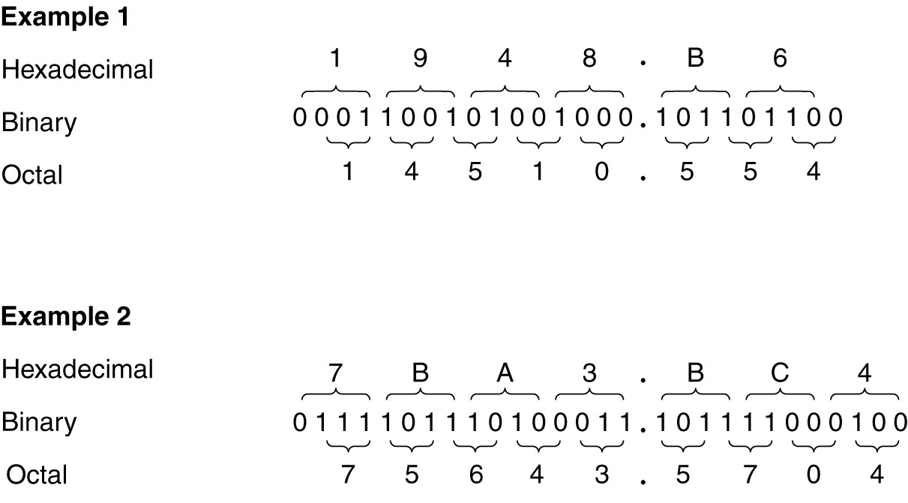
Conversion from One Radix to Another(3)
Examples of octal-to-binary and hexadecimal-to-binary conversion.
Tanenbaum, Structured Computer Organization, Fifth Edition, (c) 2006 Pearson Education, Inc. All rights reserved. 0-13-148521-0

Slide 8
Conversion from One Radix to Another(4)
Examples of octal-to-binary and hexadecimal-to-binary conversion.
Tanenbaum, Structured Computer Organization, Fifth Edition, (c) 2006 Pearson Education, Inc. All rights reserved. 0-13-148521-0

Slide 9
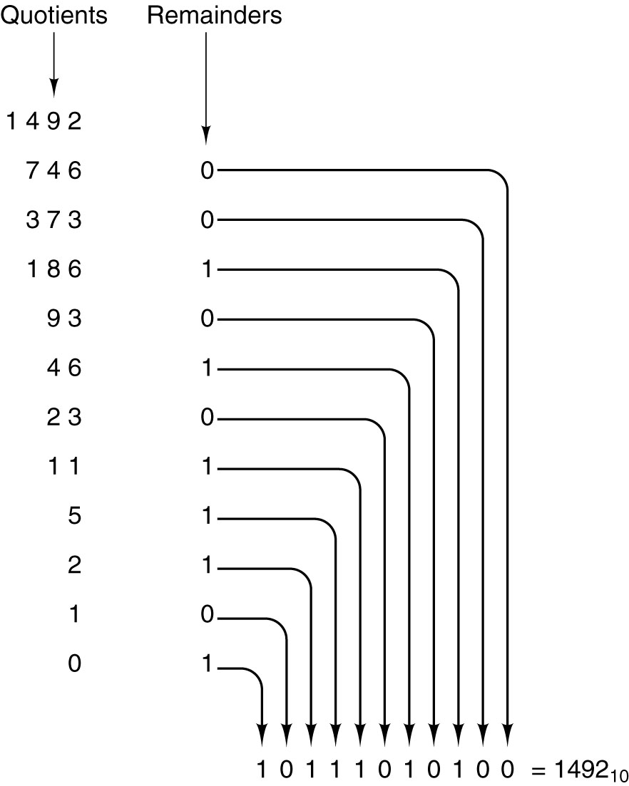
Conversion from One Radix to Another(5)
Conversion of the decimal number 1492 to binary by successivehalving, starting at the top and working downward. For example, 93 divided by 2 yields a quotient of 46 and a remainder of 1, written on the line below
Tanenbaum, Structured Computer Organization, Fifth Edition, (c) 2006 Pearson Education, Inc. All rights reserved. 0-13-148521-0

Slide 10
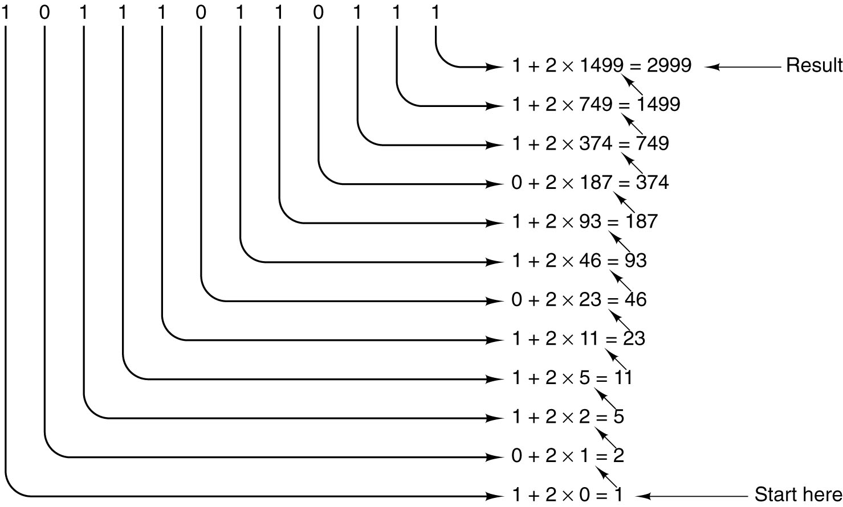
Conversion from One Radix to Another(6)
Conversion of the binary number 101110110111 to
decimal by successive doubling, starting at the bottom. Each line
is formed by doubling the one below it and adding the
corresponding bit. For example, 749 is twice
374 plus the 1 bit on the same line as 749.
Tanenbaum, Structured Computer Organization, Fifth Edition, (c) 2006 Pearson Education, Inc. All rights reserved. 0-13-148521-0

Slide 11
Representing Negative Numbers
Signed magnitude (modulo e segno)
One’s complement (complemento a uno) Two’s complement (complemento a due)
Excess 2 ^{m – 1} (notazione in eccesso di 2 ^{m – 1} )
Tanenbaum, Structured Computer Organization, Fifth Edition, (c) 2006 Pearson Education, Inc. All rights reserved. 0-13-148521-0

Slide 12
Representing Negative Numbers
Signed magnitude (modulo e segno): utilizza il bit più significativo come bit del segno (0:”+” ; 1:”-”)
Es. 00000110 (+6)
10000110 (-6)
Tanenbaum, Structured Computer Organization, Fifth Edition, (c) 2006 Pearson Education, Inc. All rights reserved. 0-13-148521-0

Slide 13
Representing Negative Numbers
One’s complement (complemento a uno): La negazione di un numero si ottiene scambiando tutti I suoi 1 con 0 e viceversa (compreso il bit del segno)
Es. 00000110 (+6)
11111001 (-6)
Tanenbaum, Structured Computer Organization, Fifth Edition, (c) 2006 Pearson Education, Inc. All rights reserved. 0-13-148521-0

Slide 14
Representing Negative Numbers
Two’s complement (complemento a due): L’opposto di un numero si ottiene in due passi: (a) si scambiano tutti i suoi 1 con 0 e viceversa (compreso il bit del segno); (b) si aggiunge 1 al risultato ottenuto.
Es. 00000110 (+6)
11111001 +
1 =
____________
11111010 (l’eventuale resto in corrispondenza del bit più
significativo viene ignorato)
Tanenbaum, Structured Computer Organization, Fifth Edition, (c) 2006 Pearson Education, Inc. All rights reserved. 0-13-148521-0

Slide 15
Representing Negative Numbers
Excess 2 ^{m – 1} (notazione in eccesso di 2 ^{m – 1} ): il numero viene rappresentato memorizzando la somma del numero stesso con 2 ^{m – 1} (per parole con m bit)
Es. (-6)+128=122 allora:
quindi (-6) con codifica excess 2^{m – 1}
è uguale a 122 → 01111010 +
Tanenbaum, Structured Computer Organization, Fifth Edition, (c) 2006 Pearson Education, Inc. All rights reserved. 0-13-148521-0

Slide 16
Representing Negative Numbers
Problemi di codifica:
  A) una sola rappresentazione dello zero
  B) uguale numero di interi positivi e interi negativi.
Tanenbaum, Structured Computer Organization, Fifth Edition, (c) 2006 Pearson Education, Inc. All rights reserved. 0-13-148521-0

Slide 17
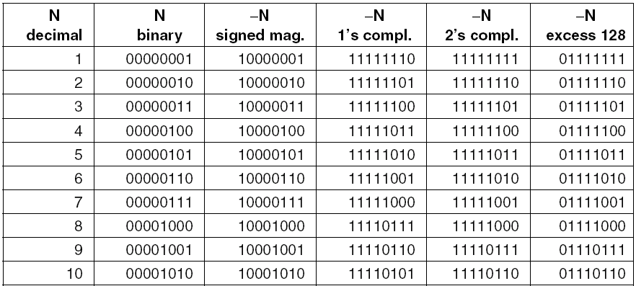
Negative Binary Numbers (1)
Negative 8-bit numbers in four systems.
Tanenbaum, Structured Computer Organization, Fifth Edition, (c) 2006 Pearson Education, Inc. All rights reserved. 0-13-148521-0

Slide 18
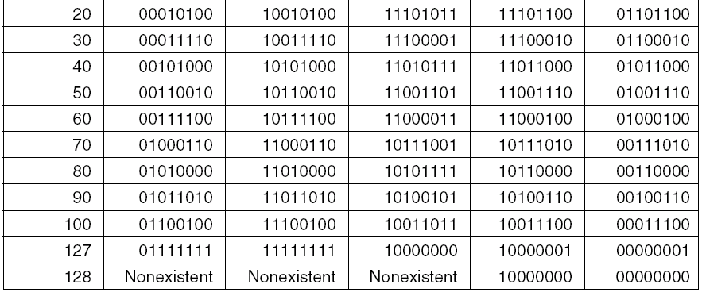
Negative Binary Numbers (2)
Negative 8-bit numbers in four systems.
Tanenbaum, Structured Computer Organization, Fifth Edition, (c) 2006 Pearson Education, Inc. All rights reserved. 0-13-148521-0

Slide 19
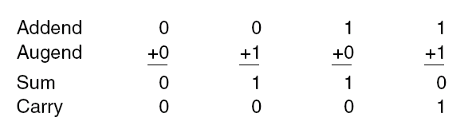
Binary Arithmetic (1)
The addition table in binary.
Tanenbaum, Structured Computer Organization, Fifth Edition, (c) 2006 Pearson Education, Inc. All rights reserved. 0-13-148521-0

Slide 20
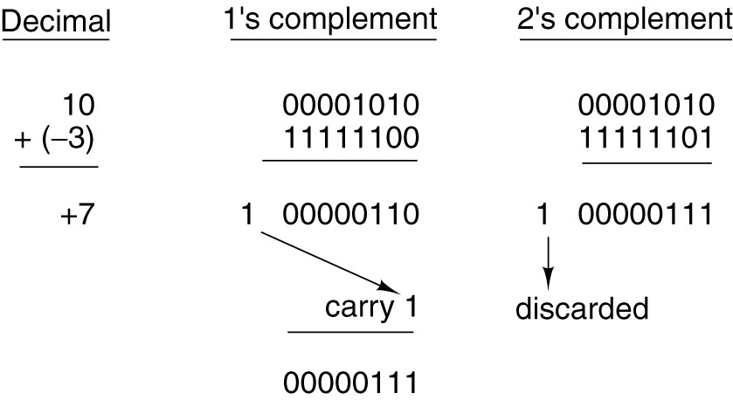
Binary Arithmetic (2)
End Around Carry
Addition in one’s complement and two’s complement.
Tanenbaum, Structured Computer Organization, Fifth Edition, (c) 2006 Pearson Education, Inc. All rights reserved. 0-13-148521-0

